Slide 1

Demystifying Face Recognition ver. TFDL
TFDL Meetup
September 2018
Presented by :
Kee Chee Yau
Machine Learning Engineer, Coqnitics

Slide 2




About Me
Passionate in Machine Learning/Deep Learning and its application in various industries
Background
2014 - Bachelor of Engineering, Monash University Malaysia
2017 - Masters in Computer Science, Universiti Sains Malaysia
Professional Background
3 years Full Stack Engineer @ Intel
½ year Data science stint @ Petronas
Current : Machine Learning Engineer @ Coqnitics
Other: Coffee Connoiseur/Addict, Avid traveller
Kee Chee Yau
Email : cheeyau@coqnitics.com
Linkedin : https://www.linkedin.com/in/chee-yau-kee-17293087/

Slide 3
Agenda
Introduction to Face Recognition
Components of Face Recognition
Face and Landmark Detection
Feature Extraction
Face Identification
Demo
* This is not a workshop. No coding required.
Notes:
1m

Slide 4
Introduction

Slide 5
Face Recognition
Biometric recognition of a person’s identity using facial features from image or video frames.
An ongoing research topic since 1980s
1980s – Eigenfaces, using principal component analysis to extract eigenfaces and perform classification
2000s – Haar Cascades, HOG, SVMs
2010 - 2xxx – Deep Learning
2014 – DeepFace by Facebook
2015 – FaceNet by Google
2016 – MTCNN face detection
2017 – SphereFace embedding

Slide 6
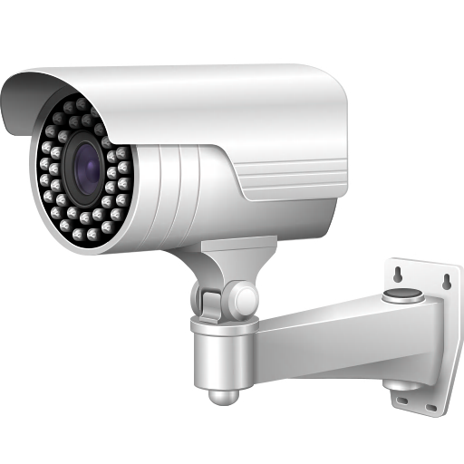
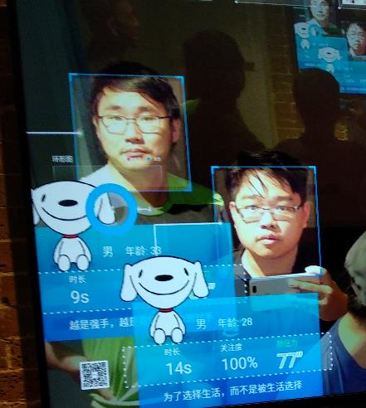
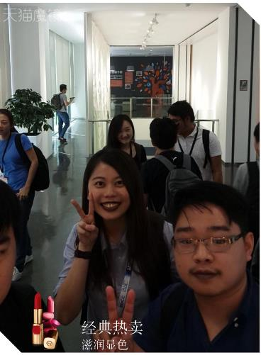
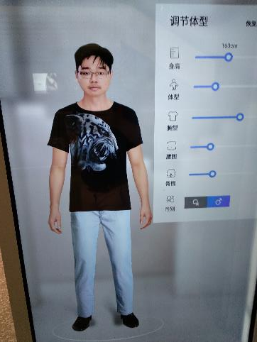
Things China do with your Faces
Jing Dong, Beijing
Alibaba, Hangzhou
MAO Mall, Hangzhou
https://www.youtube.com/watch?v=N4Gr-HLM7Qk

Slide 7

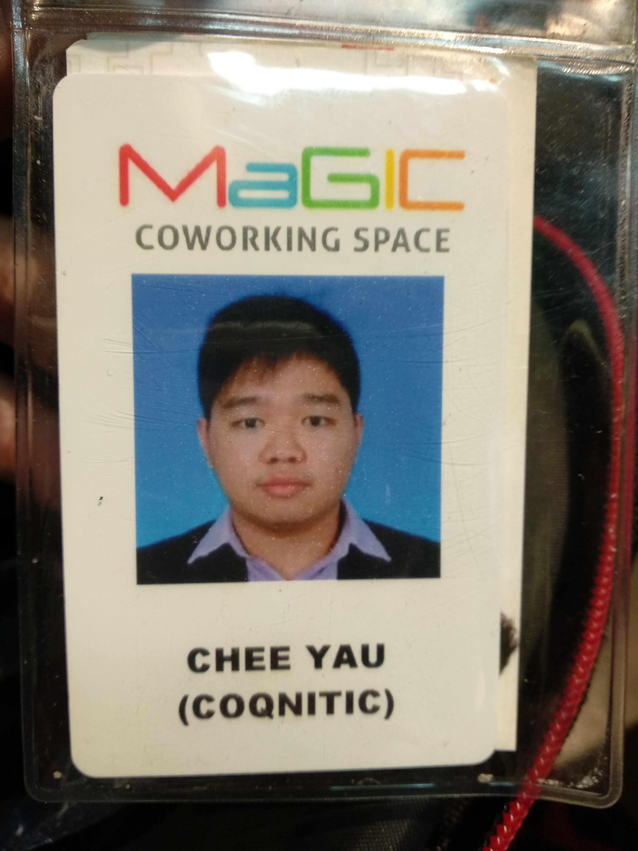


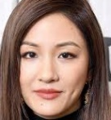

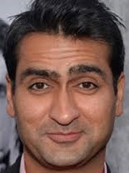

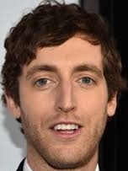
Face Verification vs Recognition
Verification :
Match ?
Identity tag
Recognition/Identification :
Who are you
Database of identities

Slide 8
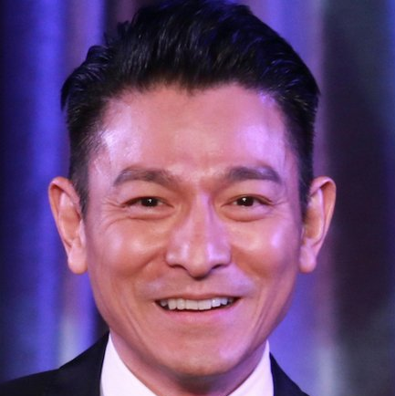
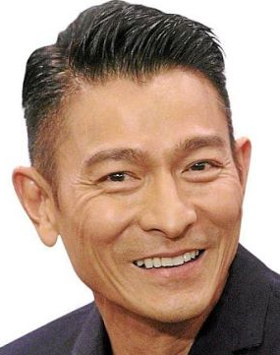
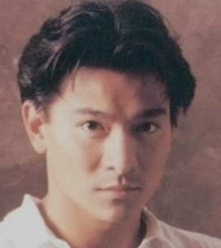
What makes a good Face Recognition System ?
Low latency (ideally in fractions of a second)
Performs well in an unconstrained environment
Highly invariant to pose, scale, rotation, lighting changes
Handles partial occlusion and changes in age
Scalable for large number of people

Slide 9
Demystifying Facial Recognition
1
Detection
2
Processing
Image/Video Frames
Face Detection
Locate Landmarks
Alignment
4
Identification
3
Feature Extraction
Identity
Classifier
Deep Embeddings
Preprocessing

Slide 10
Face Detection

Slide 11
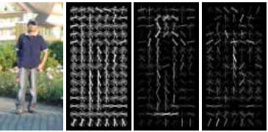
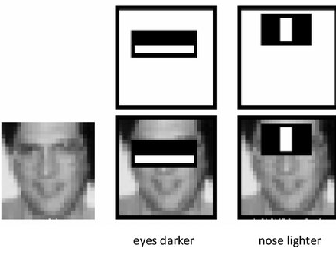
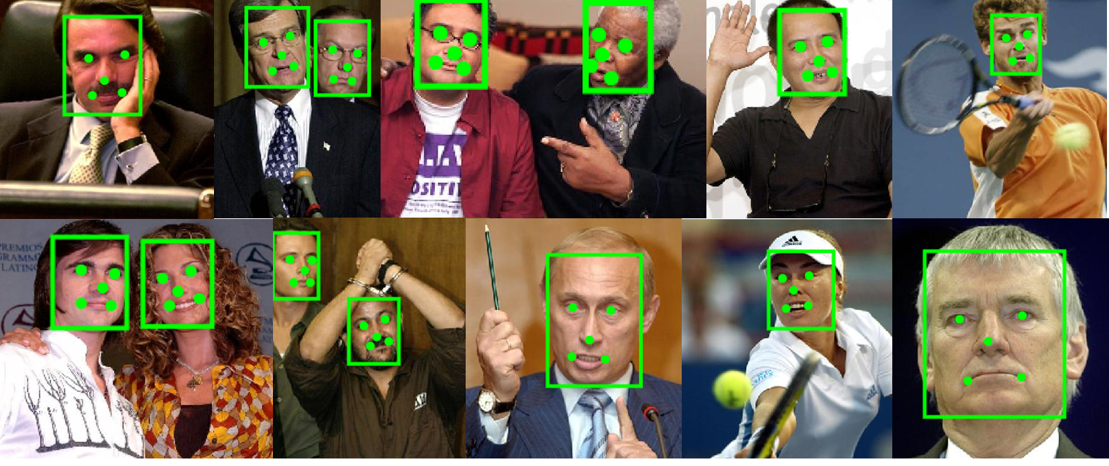
Face Detection
Detection of faces from images
Various methods
Haar Cascade and Adaboost, Viola and Jones https://www.cs.cmu.edu/~efros/courses/LBMV07/Papers/viola-cvpr-01.pdf
Histogram Of Gradients
Multi-Task Convolutional Neural Network
Viola Jones algorithm uses a series of Haar features to detect faces
HOG uses pattern of intensity gradients for object detection
MTCNN detects both faces and landmarks : https://kpzhang93.github.io/MTCNN_face_detection_alignment/index.html

Slide 12
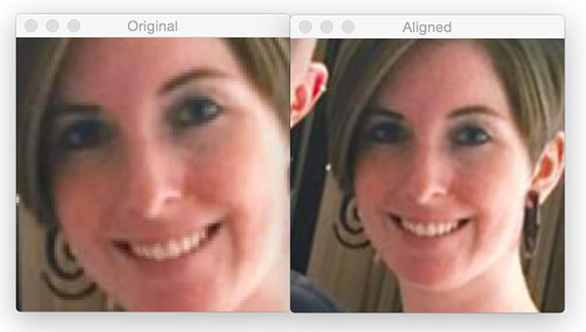
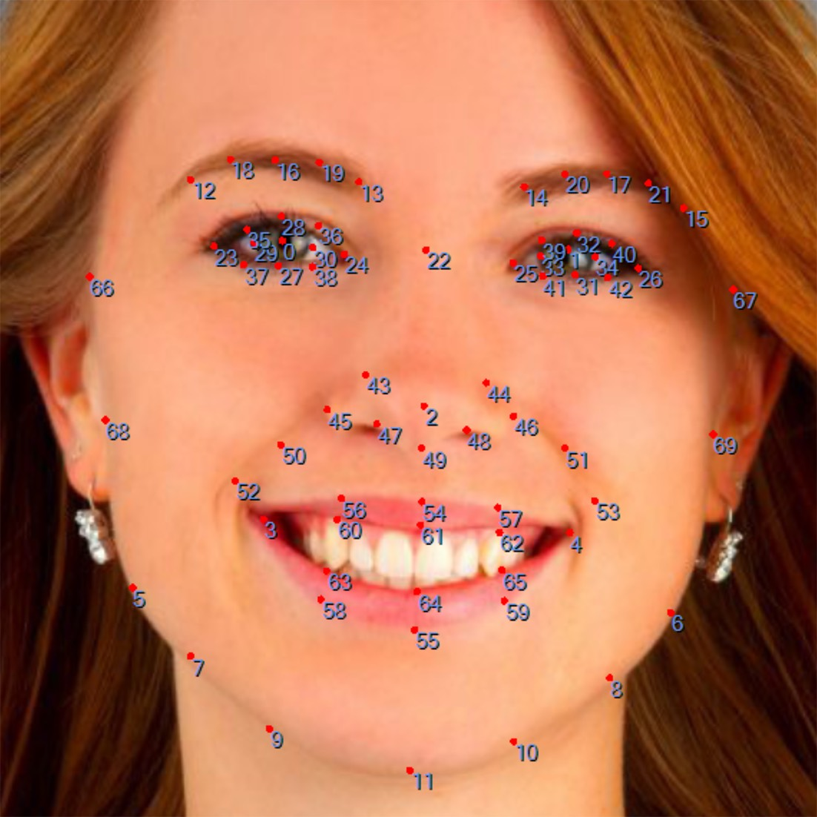
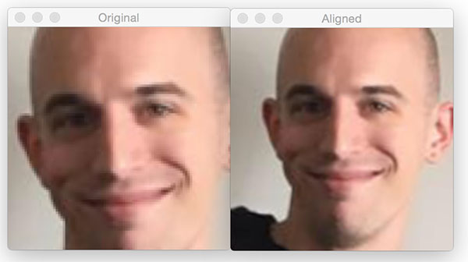
Landmark Detection
Landmark of facial features
Important to align faces before recognition
Alignment of face using affine transform. Follow tutorial here:
https://www.pyimagesearch.com/2017/05/22/face-alignment-with-opencv-and-python/
Example of a 68 point facial landmark. Number of landmark varies from system to system.
Notes:
Other uses of landmarks : Face swapping, detect smile, facial action, etc..
Number of landmarks depends on how the model is trained. Most modern models only have 5 landmarks, dlib has 68

Slide 13
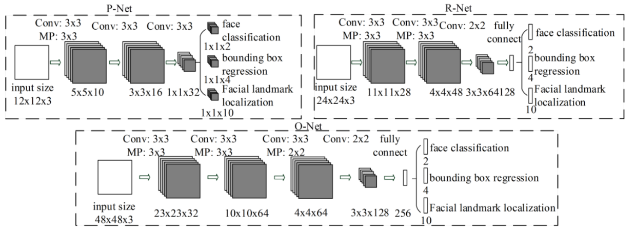
MTCNN
Current state-of-the-art
Performs both face and landmark detection
3 sequential CNNs
src: https://arxiv.org/ftp/arxiv/papers/1604/1604.02878.pdf

Slide 14
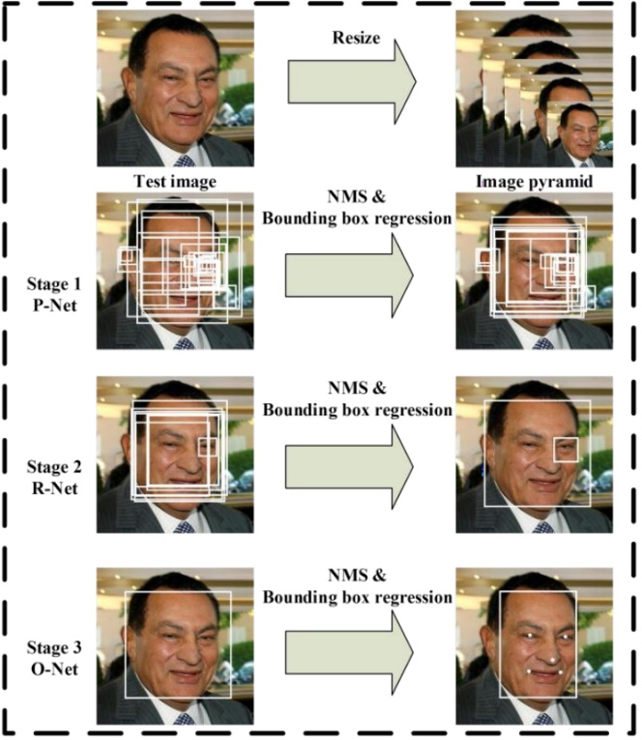
MTCNN
3 sequential CNNs
Proposal Net (P-Net) – propose candidate window using shallow CNN
Refinement Net (R-Net) – candidate refinement by rejecting non-face windows
Output Net (O-Net) – refine results and output facial landmarks position
More Parameters
src: https://arxiv.org/ftp/arxiv/papers/1604/1604.02878.pdf

Slide 15
Implementation Face Detection in Python
Category | Algorithms | Library | Resource
Face Detection | Haar Cascade | OpenCV | Google ☺
 | HOG + SVM | Dlib | Google ☺
 | MTCNN | Tensorflow | https://github.com/davidsandberg/facenet/tree/master/src/align
Landmark Detection | Ensemble | Dlib | Google ☺
 | MTCNN | Tensorflow | https://github.com/davidsandberg/facenet/tree/master/src/align

Slide 16
Feature Extraction

Slide 17
Why Feature Extraction ?
CNN
Jessica Huang
JianYang
Dinesh
Richard Hendricks
Chee Yau
Not scalable !!! Facial recognition is an open-set problem
Classifier

Slide 18
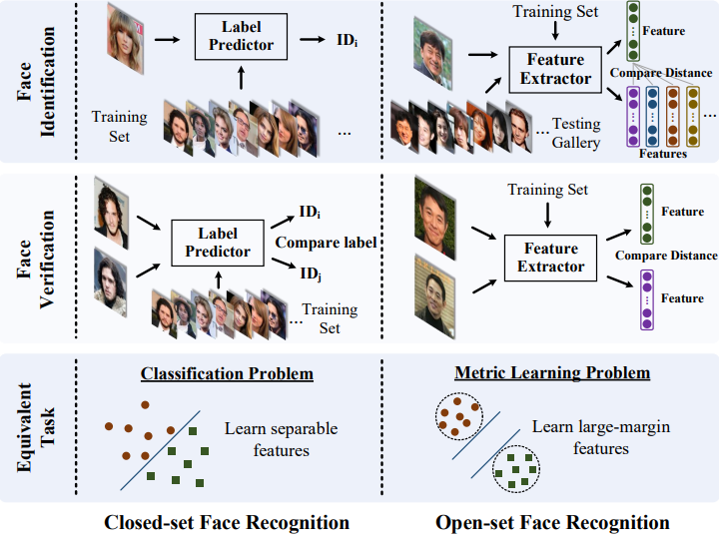
src: https://arxiv.org/pdf/1704.08063.pdf
Notes:
Features – construct distribution for each individual

Slide 19
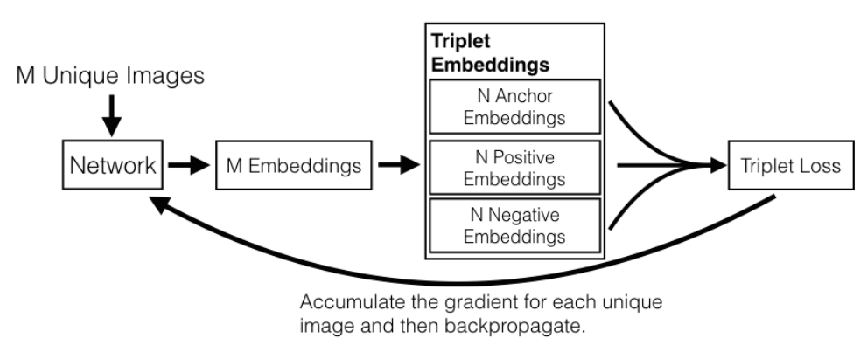
FaceNet deep face embeddings
Introduced by researchers in Google in 2015
Build on Inception models
Outputs 128D deep embeddings (original paper) which can be used for clustering, verification and recognition.
Original work was trained with
200M images/8M identities.
Triplet loss for one-shot learning
src: http://elijah.cs.cmu.edu/DOCS/CMU-CS-16-118.pdf

Slide 20
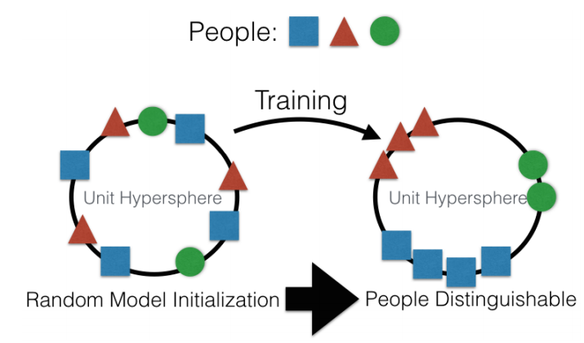
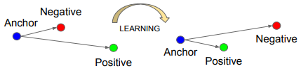
Triplet Loss
Compares 3 images at a time - an anchor to a positive (same person) and a negative (different person)
Maximise distance between anchor and negative, vice versa.
More here: https://www.youtube.com/watch?v=d2XB5-tuCWU
src : https://arxiv.org/pdf/1503.03832.pdf

Slide 21
Implementation of FaceNet
Open source version available
Tensorflow: https://github.com/davidsandberg/facenet
Torch (OpenFace): https://github.com/cmusatyalab/openface

Slide 22
Recognition

Slide 23
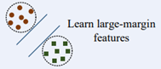
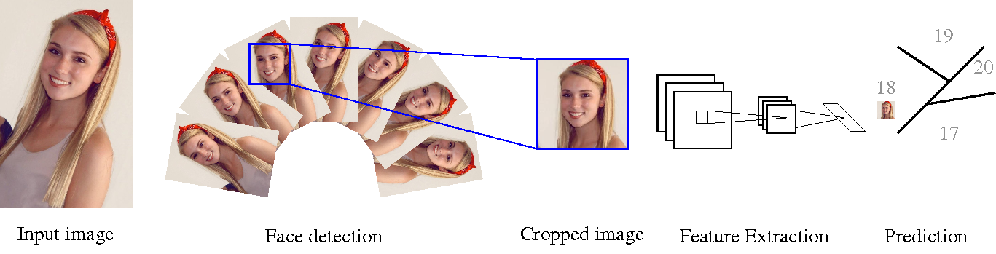
Identity Recognition
Recognize an identity using the extracted facial features. Deep embeddings are usually separable through distance metrices.
A multi-class classification problem
Multi-class SVM

Slide 24
How to select a suitable classifier
Requirements of a face classifier
Recognize up to thousands/millions of unique identities in production
Supports incremental learning (new faces need to be added from time to time)
Can be efficiently retrained (Deep learning is not suitable for this manner)
SVM is a common choice of face classifier
An evolving research problem

Slide 25
How do you get started?
Step 1 : Survey and understand the state-of-the-art.
Step 2 : Dive into each individual component and customize based on needs.
Advice : Use available resources ! Don’t reinvent the wheel unless you have plenty of development resources and years of time to market.
Plenty of resources on GitHub to get started with
Step 3 : Connect the pieces to develop your own face recognition/verification system.
Step 4 : Add other features as necessary. (Age-Gender, Emotion, Gait recognition)

Slide 26
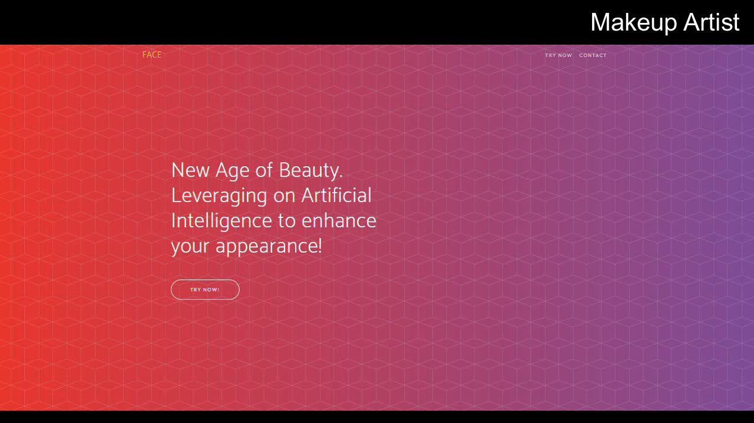
What else can you do
* If this video does not work, please refer to the videos in the drive

Slide 27
Thank You !
Any queries, contact me at
Email : cheeyau@coqnitics.com
Linkedin : https://www.linkedin.com/in/chee-yau-kee-17293087/
Notes:
2m

